Slide 1

Project Title – Exploratory Data Analysis on Super Store
Name:- Keshab Kumar
Apply ID: APPLY_172711308466f1a77c56a3d
Internship ID: INTERNSHIP_172663295366ea53f910591
AICTE ID:-STU64b68f7eda5591689685886
College:- NOIDA INSTITUTE OF ENGINEERING & TECHNOLOGY

Slide 2

PROBLEM STATEMENT
Super Store, a U.S.-based retail business, seeks to identify areas of opportunity and weakness within its sales and operations to boost profitability and streamline decision-making. Due to limited analytical expertise, the business owners require an easy-to-understand exploratory data analysis that highlights insights in simple terms and provides actionable recommendations to increase profit, improve marketing strategies, and optimize operational efficiency.

Slide 3
Project Description This project performs an exploratory data analysis (EDA) on Super Store's sales data, encompassing sales, profit, and geographic details for each order. The analysis aims to uncover high- and low-performing product categories, sub-categories, customer segments, and geographic areas. It also examines preferred shipping methods and popular product categories to pinpoint areas for improvement and growth. Through clear, straightforward insights and recommendations, this analysis supports Super Store’s owners in making data-driven decisions that align with their business objectives, helping them identify strengths, potential areas for improvement, and untapped opportunities. The key questions answered in this analysis include: Which category and sub-category perform best in terms of sales and profit? What are the top-selling and most profitable products? Which customer segment is the most profitable? Which shipping mode is preferred by customers? Which region and city show the highest sales and profitability?

Slide 4

WHO ARE THE END USERS?
The end users are the business owners of Super Store, likely one or two individuals invested in growing and managing their family-owned retail business. With limited experience in interpreting charts or statistical outputs, they need an analysis that is simple, practical, and actionable. By using layman’s terms and clear recommendations, this analysis helps them make informed decisions to improve profitability and optimize marketing and operational strategies, without requiring deep technical expertise.

Slide 5

Technology Used
Pandas
Numpy
Matplotlib
Seaborn
Python

Slide 6
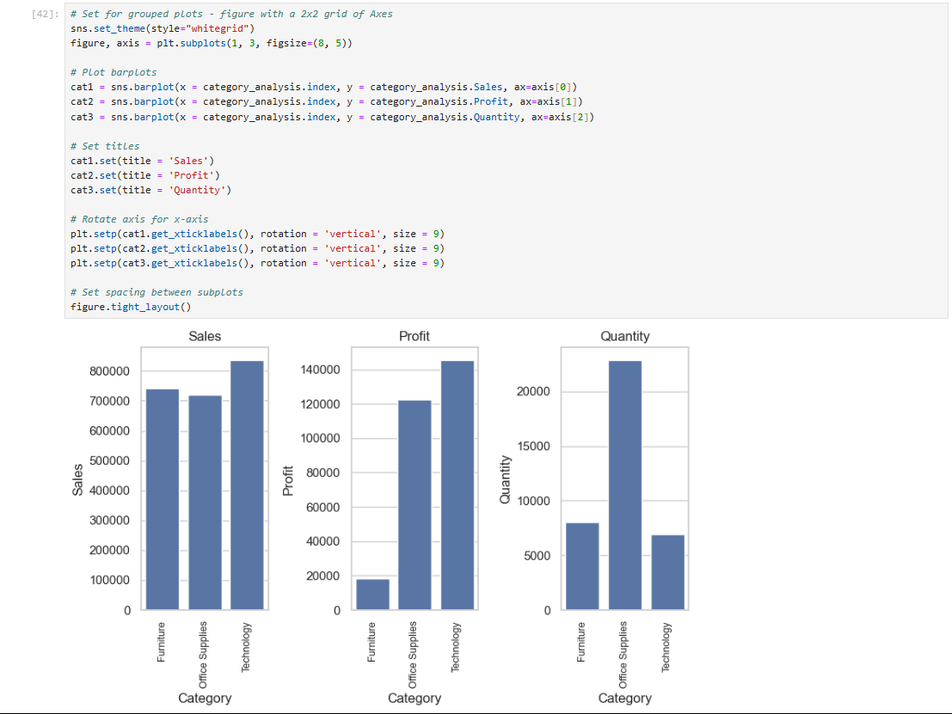
RESULTS
Demo

Slide 7
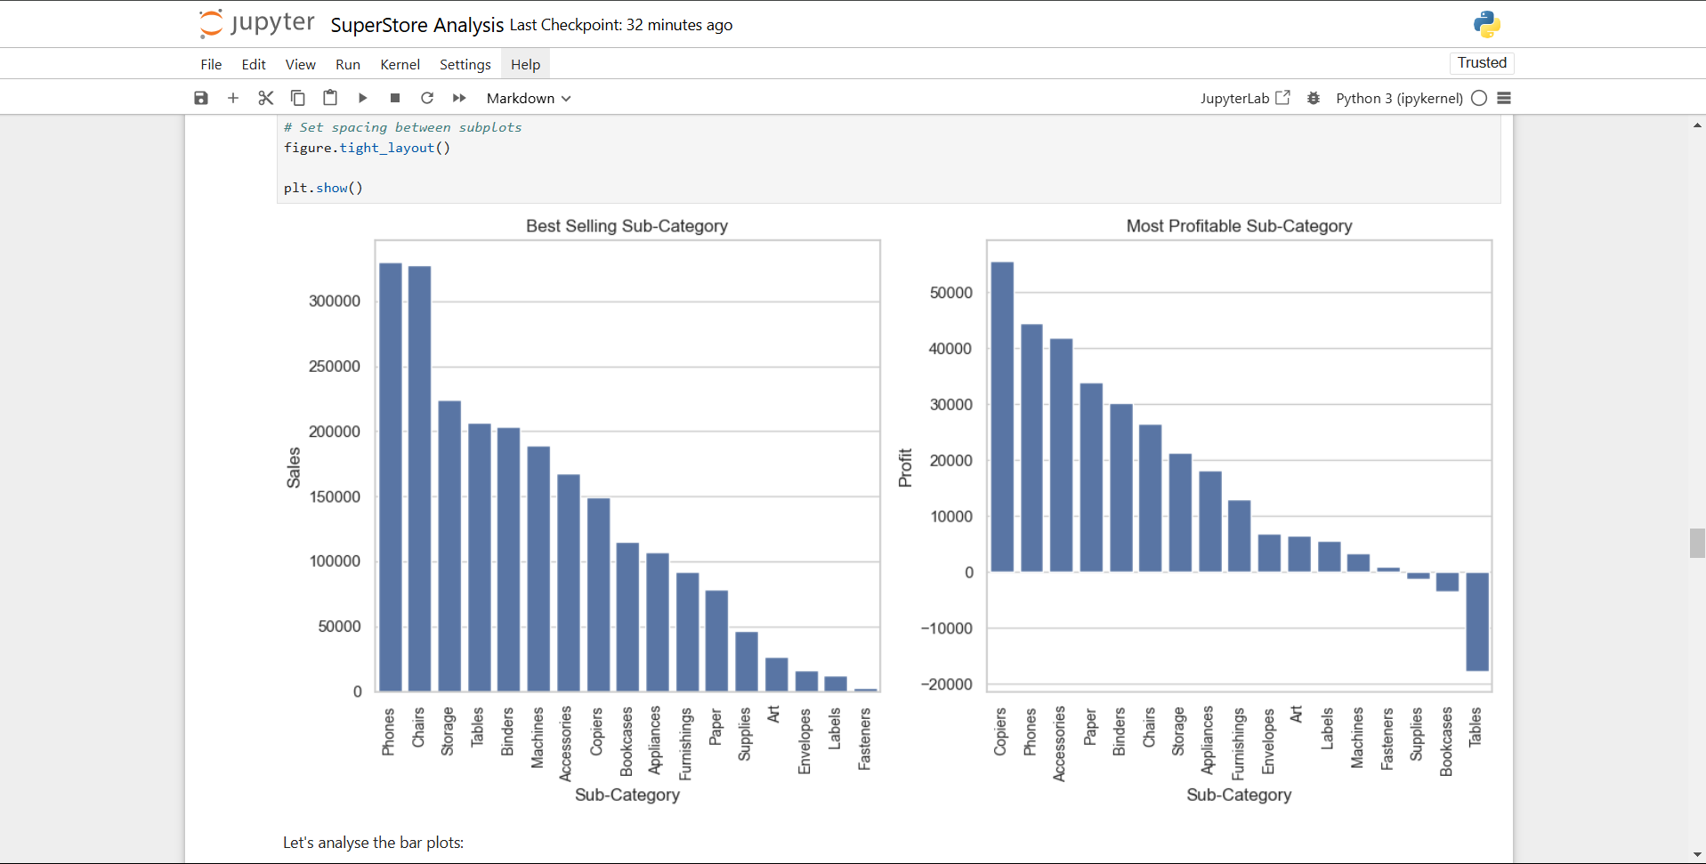
RESULTS
Demo

Slide 8
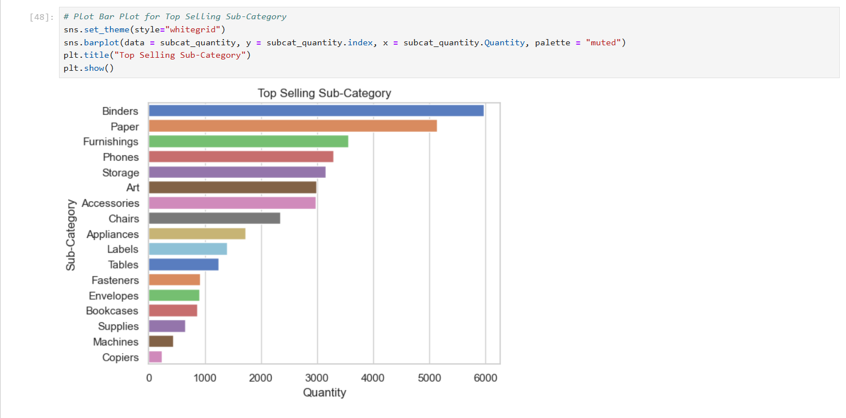
RESULTS
Demo

Slide 9
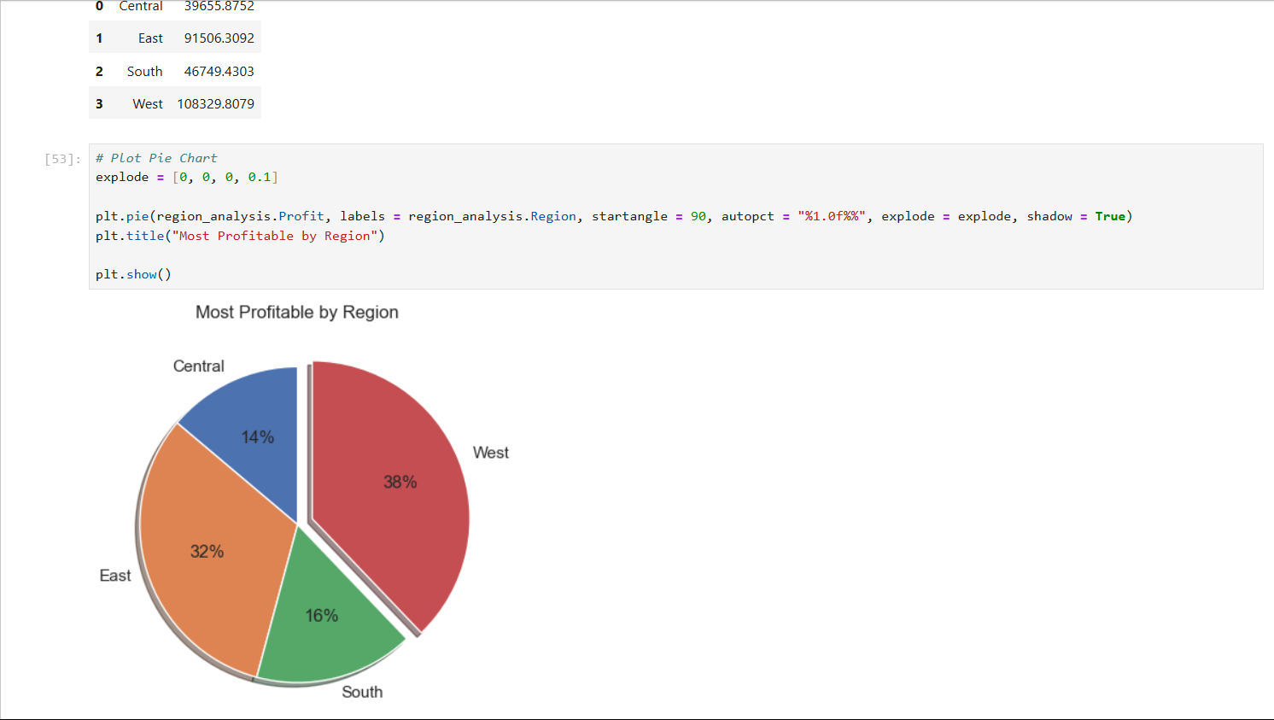
RESULTS
Demo

Slide 10
Thank you
Keshab Kumar Noida Institute Of Engineering and Technology
https://www.kaggle.com/code/keshabkkumar/super-store-analysis
https://github.com/Keshabkjha/AICTE_VOISE_Internship
.
.

